Slide 1
Managed Contracts
Melitta Andersen Mike Barnett Manuel Fähndrich Brian Grunkemeyer Rustan Leino Francesco Logozzo Wolfram Schulte
MSR
CLR

Slide 2
Contracts In Microsoft
Big success in Windows (> 13% of bugs in Server 2003 were Prefix/ESP detected)
No contracts for managed code, but time moves on, better checker, more experience
Therefore: Proposal for managed code with many benefits that goes beyond Prefix/ESP experience
It is time for Microsoft to put a stake in the ground and commit to supporting programming by contract on our managed platform, thereby improving both the developer experience outside, as well as inside of Microsoft. —Manuel Fähndrich, Managed Contracts proposal

Slide 3
Chicken and Egg Problem
Languages want to see need/benefit first
Users can’t express contracts by themselves
Contract ecosystem necessary
Solution: Managed Contracts
Language independent
Declarative
Modular
Extensible
Support downstream tools
Languages can provide support later

Slide 4
Design Space
global analysis
modular analysis
Managed Contracts
Dynamic checking provides test amplification
ESP
expressivity
FxCop
Prefast/SAL
Prefix
static checking
dynamic checking

Slide 5
Historical View
Spec#
Managed Contracts
expressivity
SAL
Prefix
FxCop
1999
2000
2003
2008
Notes:
Managed contracts slightly lower than Spec# because of lack of non-null type system.

Slide 6
Contracts Ecosystem
Enables full stack to take advantage of contracts
Client + Contracts
Client
Client + Contracts
Clients add contracts in response to tools
Client
BCL + Contracts
Clients need contracts on their dependencies
BCL

Slide 7
Managed Contracts Today
An API for expressing contracts
Can be used from any .NET language
Method preconditions and postconditions
Object invariants
Reference Assemblies for contract persistence
Runtime checking
CCI-based binary rewriter
Static checking
Clousot — an abstract interpreter
Spec#-lite — an automatic theorem prover (Boogie)
Testing
Pex

Slide 8
Managed Contracts: Benefits
API Documentation
Auto-generated
Intellisense
Validated
Test Amplification
Contracts provide oracles
Other tools can use them (Pex, Clousot)
Useful both inside MS and for client
Static Checking: find bugs earlier
Continuum from abstract interpretation to theorem proving

Slide 9
Managed Contracts: Example
Declarative
public virtual int Add(object value) { Contract.Requires(value != null); Contract.Ensures(Count == Contract.Old(Count) + 1); Contract.Ensures(this[Contract.Result<int>()] == value); Contract.Ensures(Contract.Result<int>() == Contract.Old(Count)); Contract.EnsuresOnThrow<ObjectDisposedException>(this.IsDisposed); if (_size == _items.Length) EnsureCapacity(_size + 1); _items[_size] = value; return _size++; }
Prestate and Return Value
Class-wide properties
void ObjectInvariant(){ Contract.Invariant(_items != null); }

Slide 10
Managed Contracts: Semantics
Requires(P)
P must hold on method entry.
Ensures(Q)
Q must hold on method exit, when method terminates normally.
EnsuresOnThrow<T>(Q)
Q must hold on method exit, when method terminates exceptionally and the exception is a subtype of T.
Invariant(J)
For public methods, J is assumed to hold at entry and is checked at normal exit. It is checked at exit for all public constructors.

Slide 11
Foxtrot Tool Chain: Library
C# source
csc
MSIL
+
§Contract.Requires(bool); *Contract.DebugRequires(bool); *Contract.Ensures(bool); *Contract.EnsuresOnThrow<T>(bool); *Contract.EnsuresFinally(bool) *Contract.Throws<T>(); *Contract.Assert(bool); *Contract.Assume(bool); *Contract.Invariant(bool);
contract library
* Conditionally defined on FEATURE_FULL_CONTRACTS
§ Conditionally defined on FEATURE_RUNTIME_PRECONDITIONS or FEATURE_FULL_CONTRACTS

Slide 12
Foxtrot Tool Chain: Retail Build
C# source
csc
MSIL
+
Conditional compilation leaves only required parameter validation checks, which are already at the right place in the code.
contract library

Slide 13
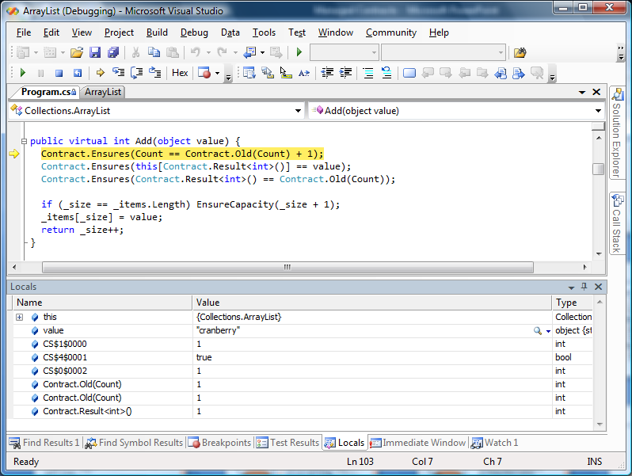
Runtime Checking Demo

Slide 14
Runtime Checking
Introduce locals to hold “old” values.
Introduce local to hold return value, replace Contract.Result with local.
Move (normal) postconditions to unified exit point.
Wrap method in a try block for checking exceptional postconditions (throws contracts).
Debugging experience is preserved: PDB files are rewritten as well.

Slide 15
Foxtrot Tool Chain: Runtime Checking
FEATURE_FULL_CONTRACTS
C# source
csc
MSIL
+
MSIL
contract library
Runtime Checking
rewriter

Slide 16
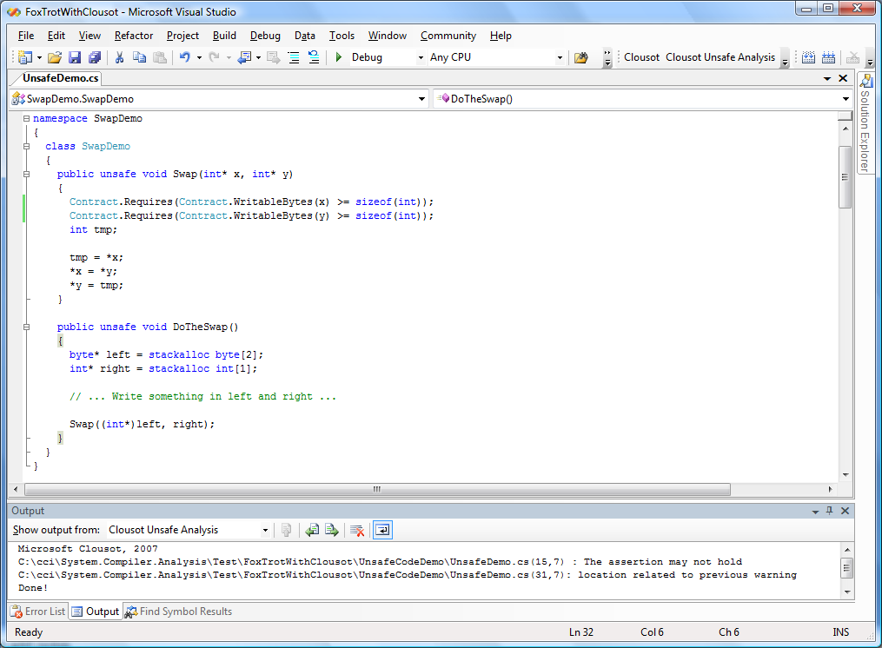
Static Checking Demo
Precondition violated

Slide 17

Clousot
A generic static analyzer based on Abstract Interpretation
Current Checks:
Null dereferences
Array bounds
Memory accesses (in unsafe code!!)
Foxtrot contracts (e.g. method pre-, post-conditions)
Automatic
Uses Foxtrot annotations to improve precision
Works (today!) on all .NET assemblies

Slide 18
Foxtrot Tool Chain: Static Checking
C# source
csc
MSIL
+
extractor
contract library
FEATURE_FULL_CONTRACTS
Specification
Code
static checker
Static Checking

Slide 19
Contract Usage
Declarative: a prefix of the method body.
Summary: members referenced in public contracts must be at least as visible as the method.
Pure: contracts cannot modify the state:
Correct code should be able to have the contracts removed
No updates allowed (++, etc.)
Method calls in contracts must be marked [Pure].
Separate purity checker coming soon!

Slide 20
Persistance: Reference Assemblies
library
csc
MSIL
extractor
Reference Assembly
client code
csc
MSIL
downstream tool
Managed version of a C++ header file.
Already used internally (asmmeta)
Persist contracts in addition to metadata (really is part of the signature)

Slide 21
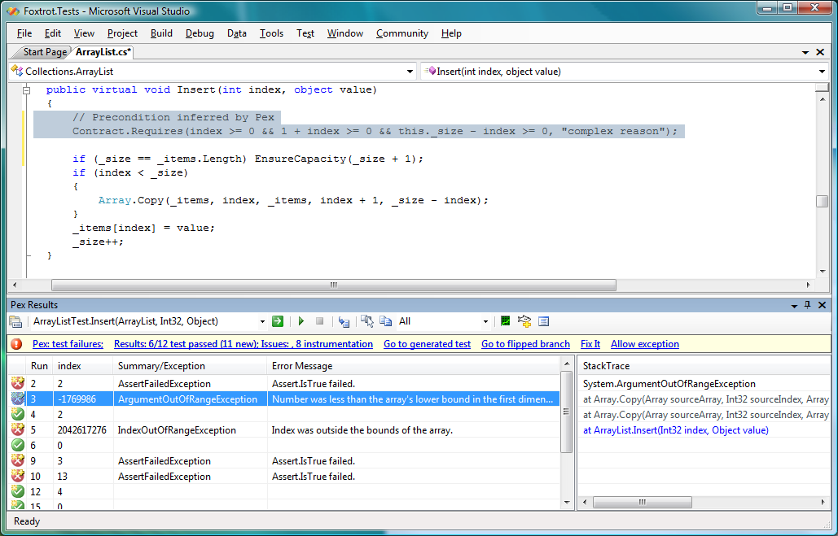
Contract Inference
Pex
Pex supplies contracts
Pex shows harmful arguments
Pex analyzes root cause

Slide 22
Pex
Pex monitors .NET program execution
Instruments code, injects callbacks at JIT time
Callbacks monitor how test inputs are used
Pex fuzzes test inputs
Builds constraint systems of potential bugs and missing coverage
Uses constraint solver to generate new tests
As a side effect, Pex finds bugs
Contract-aware
Finds only real bugs, no spurious warnings
Result: Minimal test suites with high coverage

Slide 23
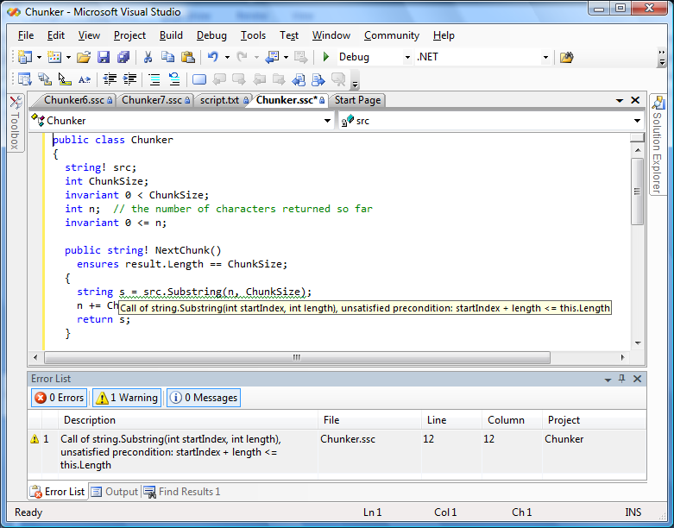
Spec#: The Long Term Vision

Slide 24

Spec#
Research vehicle for pushing state-of-the-art in object-oriented program verification.
Full language support for contracts. Has a nonnull type system.
Full VS integration
Contracts available as part of Intellisense.
Design-time static checking: “red squigglies as you type”™
Robust enough for experimental usage. Strict superset of C# v2. (Parts of the Spec# system are written in Spec#.)
Uses a fully-automatic theorem prover for static checking.

Slide 25
Extensibility
Express new properties as pure methods; use within existing contracts. bool Monitor.LockHeld(object o);
Can easily be made conditional. a == null || Contract.Result<T>() != null
Refactoring-aware.
Contract API vs. custom attributes
Scales to full expressions
Type checking, error checking

Slide 26
Extensibility: Concurrency Example
class ESPC { bool GuardedBy(object o, object guarder){ … } bool GuardedBy<T>(ref T o, object guarder){ … } }
class C { D f; void ObjectInvariant(){ Contract.Invariant(GuardedBy(ref this.f, this)); … } }

Slide 27
Language Integration
Contracts are a unifying concept:
Nonnull types are contracts on parameters, return values, and fields.
Where clauses on data fields are invariants.
Contracts as a first-class language element enrich the user experience.
Compiler can provide support for runtime checking, contract inheritance.

Slide 28
Summary
The time for contracts is now.
A language-independent solution offers the opportunity to make a standard contract language for all tools.
Research prototypes exist for:
Reference assemblies
Binary rewriting
Static analysis (2 flavors!)
Contract-aware test case generation

Slide 29
Links
Foxtrot: http://specsharp/foxtrot
Clousot: http://sharepoint/sites/Clousot
Spec#: http://research.microsoft.com/specsharp
Pex: http://codebox/pex

Slide 30
Contract Documentation
Our tool augments XML doc files
Adds requires, ensures, invariants
Sandcastle used to build documentation
Questions:
Language specific tags in XML doc?

Slide 31
Backup Slides

Slide 32
Contract Usage
Declarative: a prefix of the method body.
Summary: members referenced in public contracts must be at least as visible as the method.
Pure: contracts cannot modify the state:
Correct code should be able to have the contracts removed
No updates allowed (++, etc.)
Method calls in contracts must be marked [Pure].
Separate purity checker coming soon!

Slide 33
Preconditions
public virtual int Add(object value) { Contract.Requires(value != null ? null : new ArgumentNullException(…)); …
Requires is always defined.
Ternary expression avoids evaluation of exception resources on good paths. Note polarity of condition.

Slide 34
Postconditions
public virtual int Add(object value) { Contract.Ensures(Count == Contract.Old(Count) + 1); Contract.Ensures(this[Contract.Result<int>()] == value); … }
Ensures is conditionally defined.
Old refers to values in the prestate.
Result is replaced by the return value.

Slide 35
Throws Clauses
public int Receive(byte[] buffer) { Contract.ThrowsEnsures<ObjectDisposedException> (this.IsDisposed); … }
ThrowsEnsures is conditionally defined.
Postcondition on exceptional paths.
Can be used for checking exception propagation. (Not part of Foxtrot yet.)

Slide 36
Summary: Method Contracts
Requires: public precondition
Ensures: public postcondition
ThrowsEnsures: public exceptional postcondition
Assert: private precondition
AssertOnReturn: private postcondition
AssertOnException: private exceptional postcondition

Slide 37
Object Invariants
void ObjectInvariant() { Contract.Invariant(0 <= _s && _s <= _xs.Length); Contract.Invariant( // all unused slots are null Contract.ForAll(_s,_xs.Length, i => _xs[i] == null); }
Checked at public method exit.
Assumed at public method entry.
[InvariantMethod] can mark method.
Invariants are conditionally defined.

Slide 38
Quantification
public static bool ForAll(int lo, int hi, System.Predicate<int> P) { Contract.Requires(lo <= hi && P != null); for (int i = lo; i < hi; i++) if (!P(i)) return false; return true; }
Contract.ForAll, Contract.Exists
Other quantifiers possible: Count, Sum, etc.

Slide 39
Quantification Example
Contract.Forall(_size,_items.Length, delegate(int i) { return _items[i] == null; });
C# v2
Contract.Forall(_size,_items.Length, i => _items[i] == null);
C# v3
_items.Forall(x => x == null);

Slide 40
Contracts On Abstract methods
public interface ICloneable { object Clone(); }
public class CloneableContract : ICloneable { object ICloneable.Clone(){ Contract.Ensures(Contract.Result<object>() != null); return Contract.Result<object>(); } }
[ContractClass(typeof(CloneableContract))]

Slide 41
Assert and Assume
Contract.Assert(P); Contract.Assume(P);
For runtime checking:
They are identical: error if P is false
For static checking:
Assert(P): P must be proven
Assume(P): P is a fact added to the verification
Use Assume to make the static checker be quiet. But be careful!
Similar to shutting off FxCop violation, but with documentation in the code.

Slide 42
Out-Of-Band Contracts
using Microsoft.Contracts; namespace System { public class String { public String Substring(int start, int length){ Contract.Requires(0 <= start); … }
Name it Original.Contracts.dll. (Can use the Spec# compiler if you don’t want to add method bodies.)
Use /c option to the rewriter.

Slide 43
Foxtrot Tool Chain
C# source
csc
MSIL
+
MSIL
extractor
contract library
Runtime Checking
rewriter
Specification
Code
static checker
Static Checking

Slide 44
Abstract Interpretation
Static analysis (similar to dataflow analysis in a compiler, but more powerful):
Infinite domains
Widening/Narrowing
Fully automatic
Can infer loop invariants and postconditions
Checks specific properties coded into analysis
Predictable running time (as opposed to theorem proving)

Slide 45
Theorem Proving
Program is converted to a mathematical formula: errors in formula mean error in program
Fully automatic
Is not sound (unless a very restricted programming model is used, cf. Spec#)
Checks arbitrary contracts written by programmer

